Slide 1

Logistic Regression & Introduction to Artificial neural networks.

Slide 2

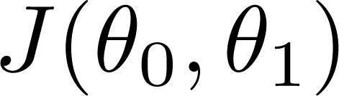


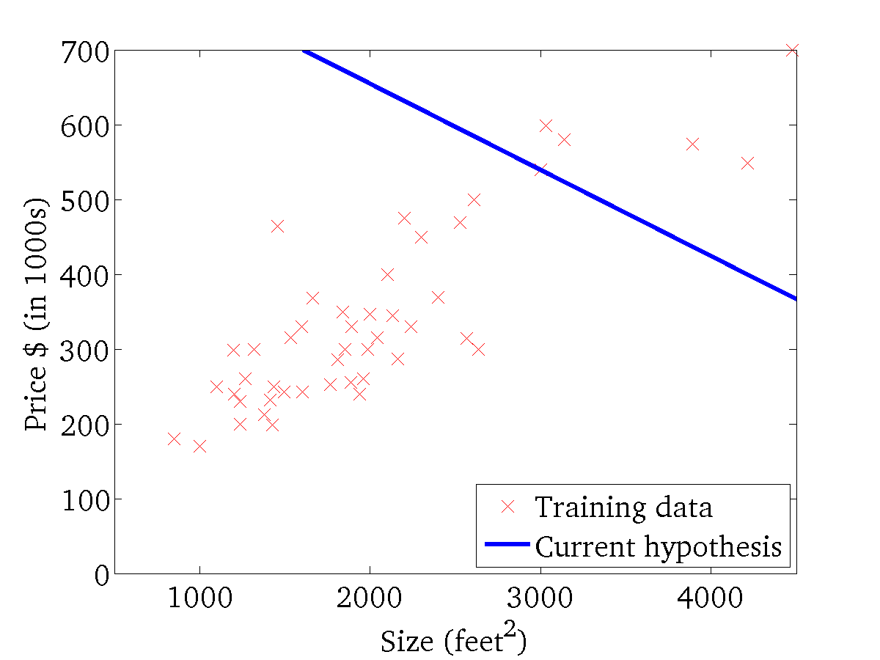
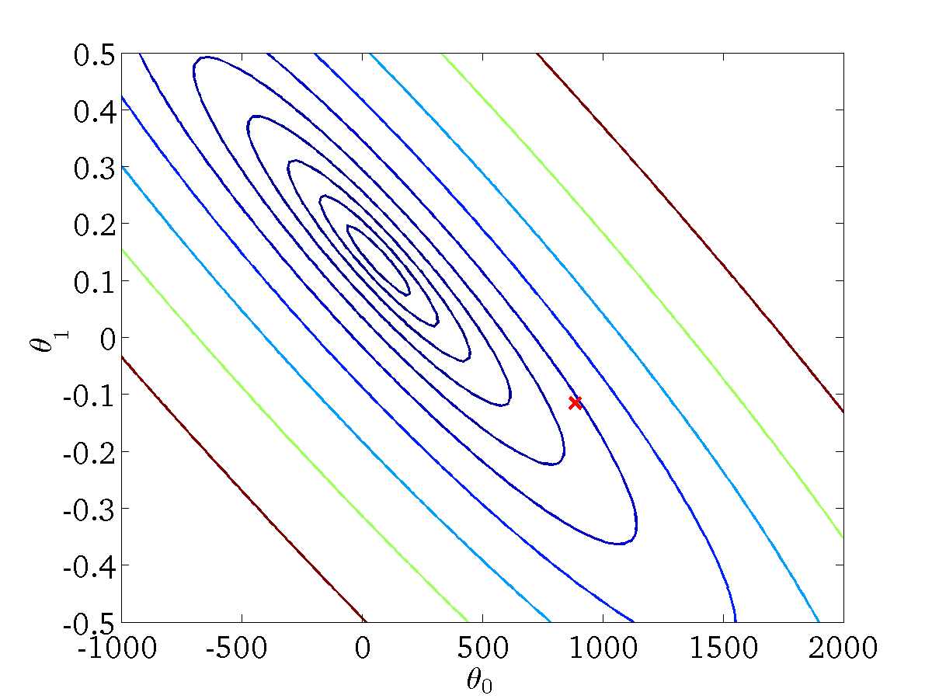
(for fixed , this is a function of x)
(function of the parameters )

Slide 3
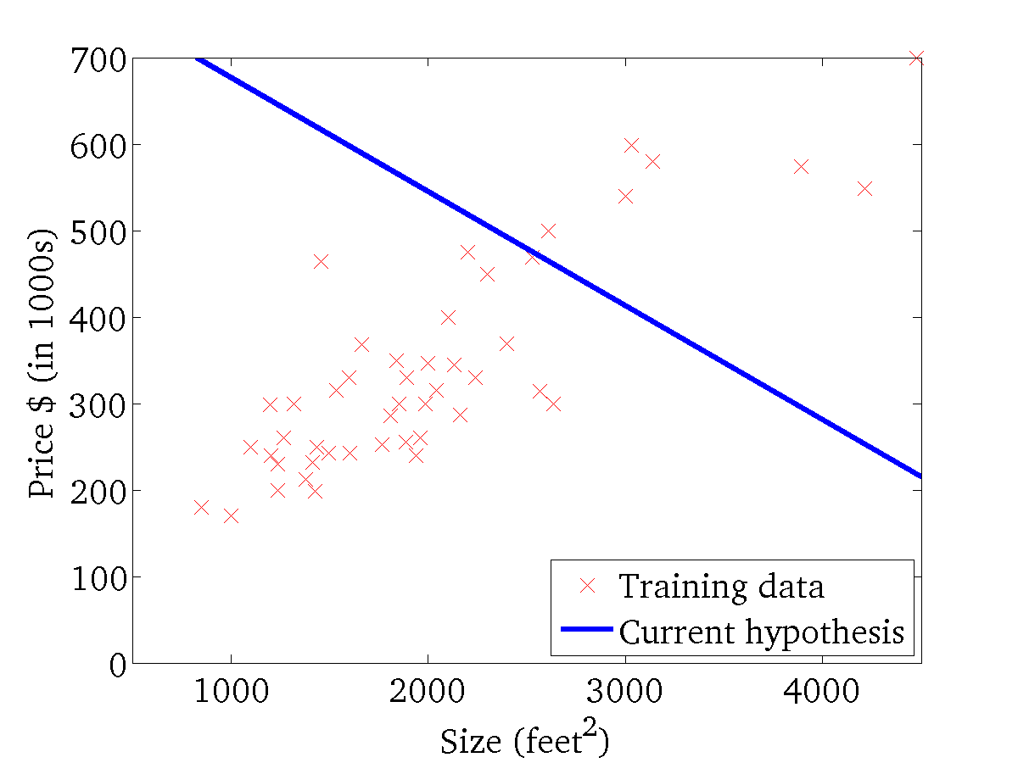

(for fixed , this is a function of x)
(function of the parameters )

Slide 4
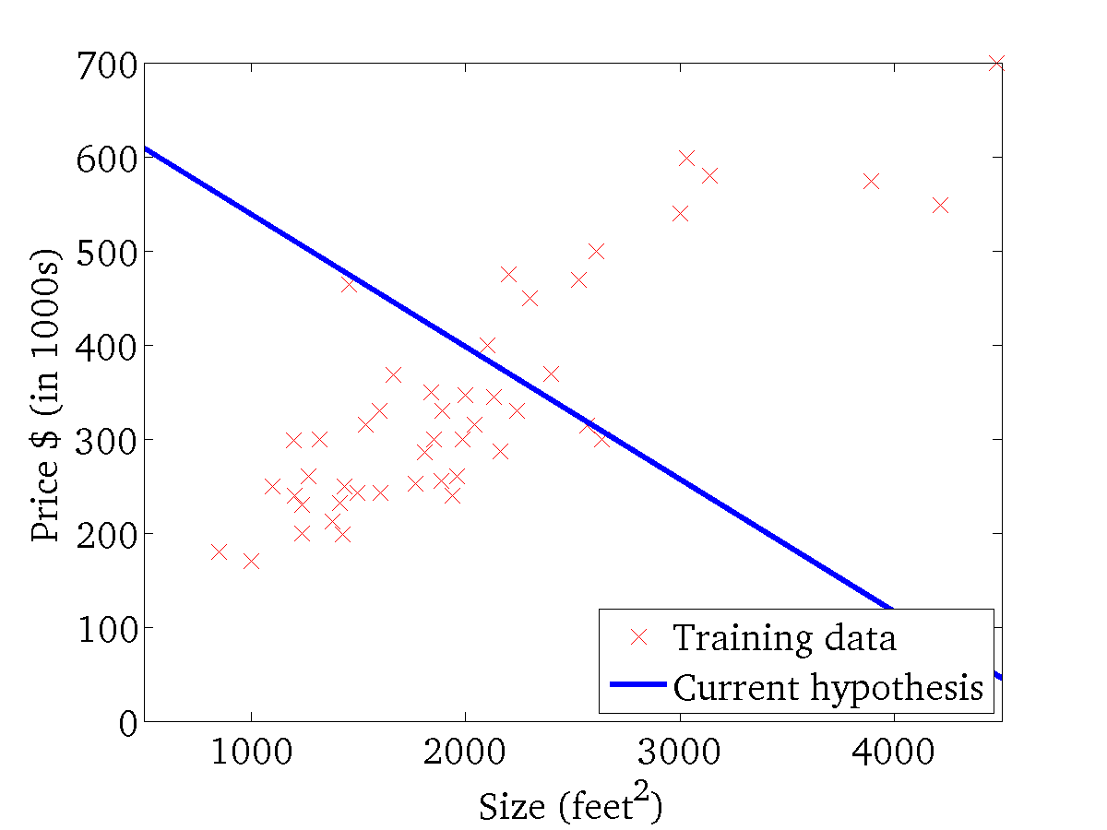
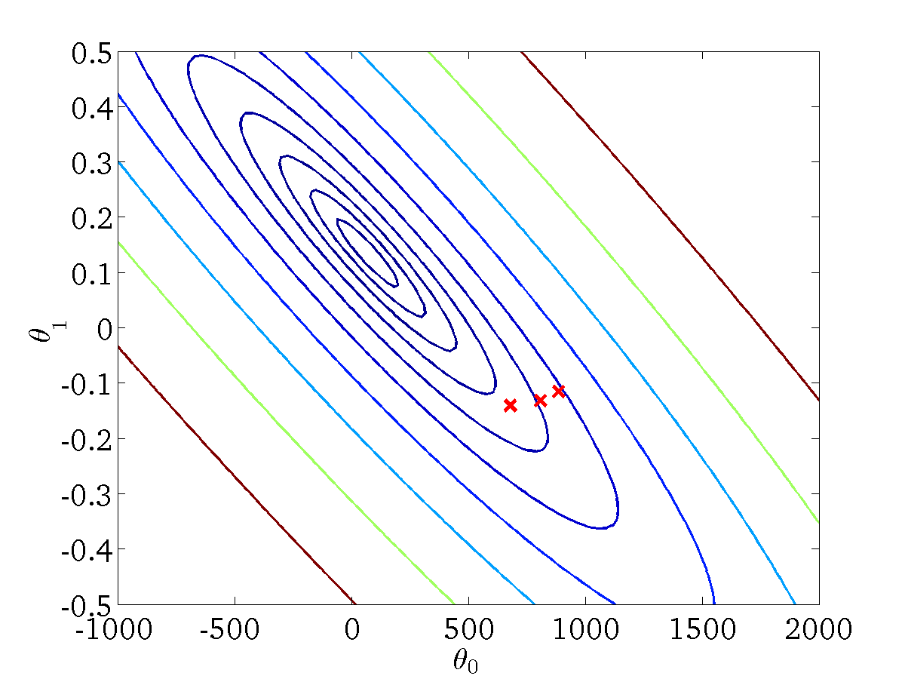
(for fixed , this is a function of x)
(function of the parameters )

Slide 5
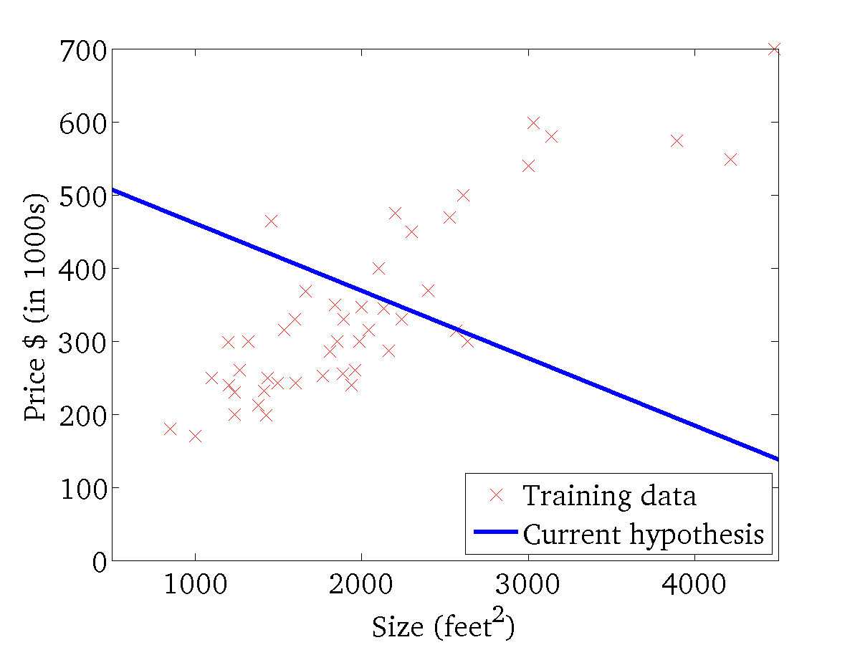

(for fixed , this is a function of x)
(function of the parameters )

Slide 6
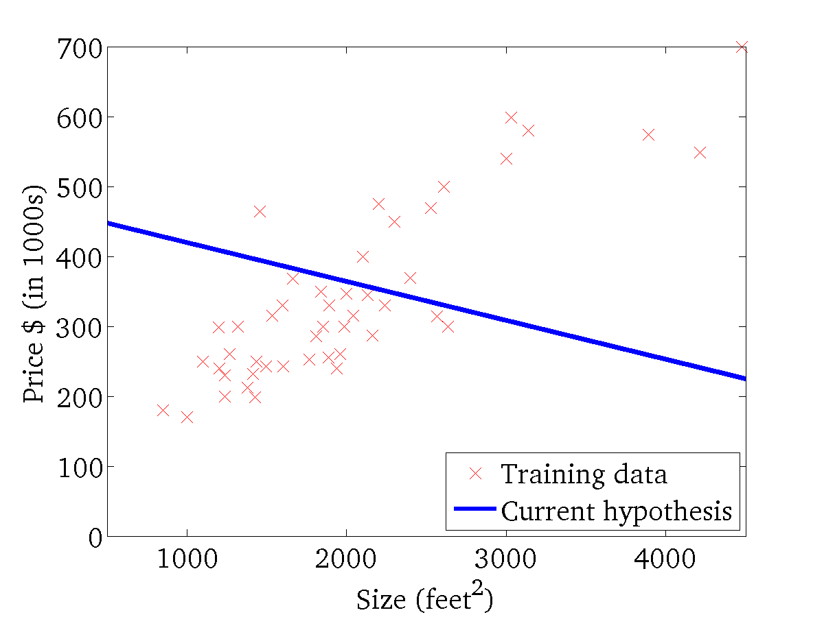
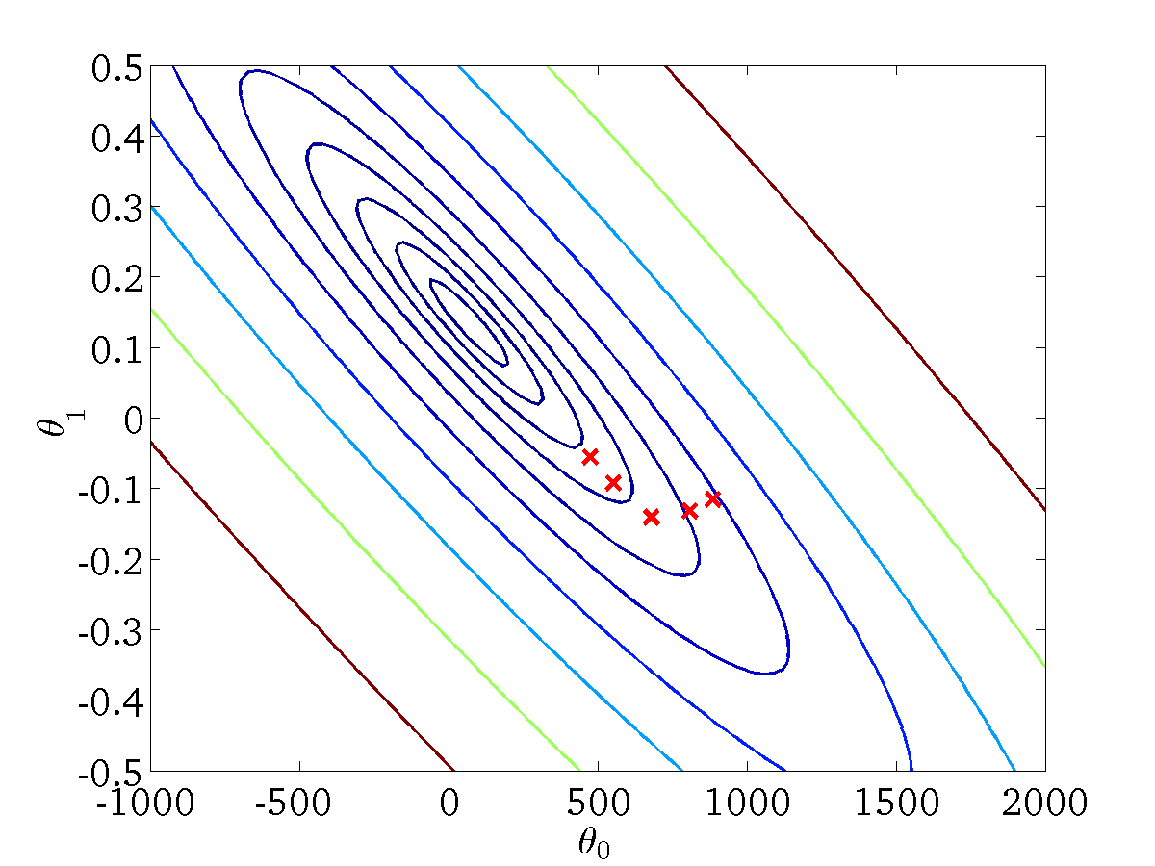
(for fixed , this is a function of x)
(function of the parameters )

Slide 7
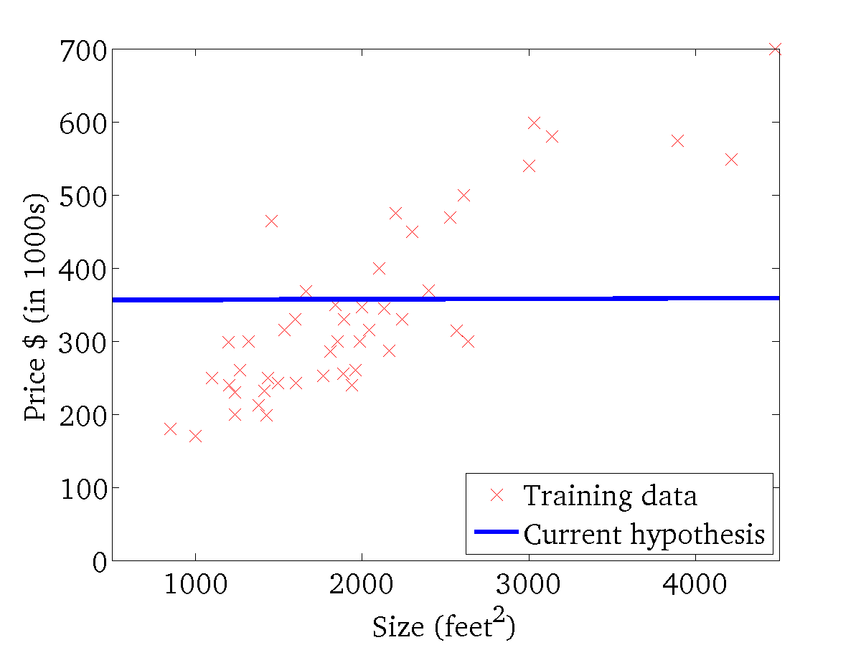

(for fixed , this is a function of x)
(function of the parameters )

Slide 8
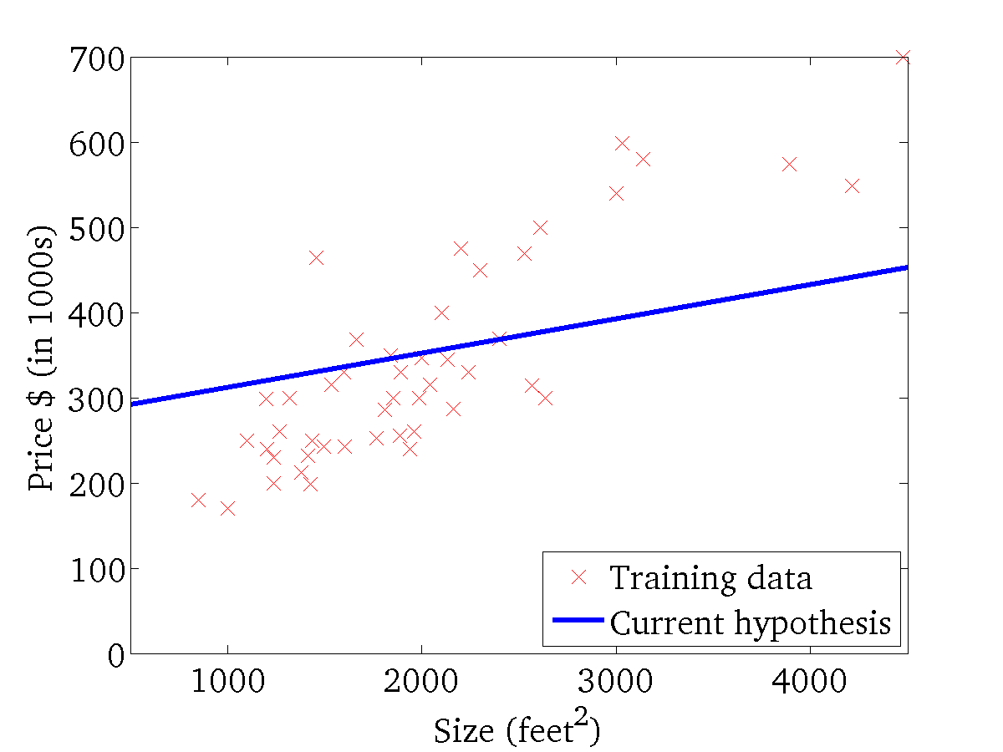

(for fixed , this is a function of x)
(function of the parameters )

Slide 9
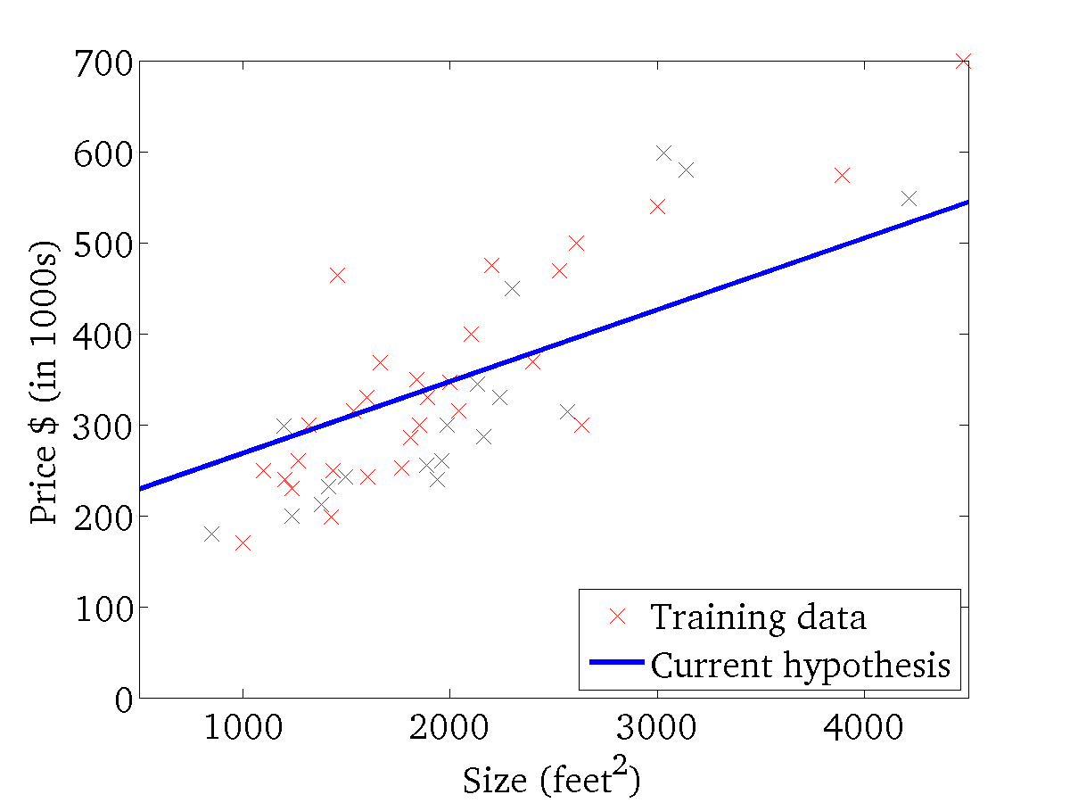
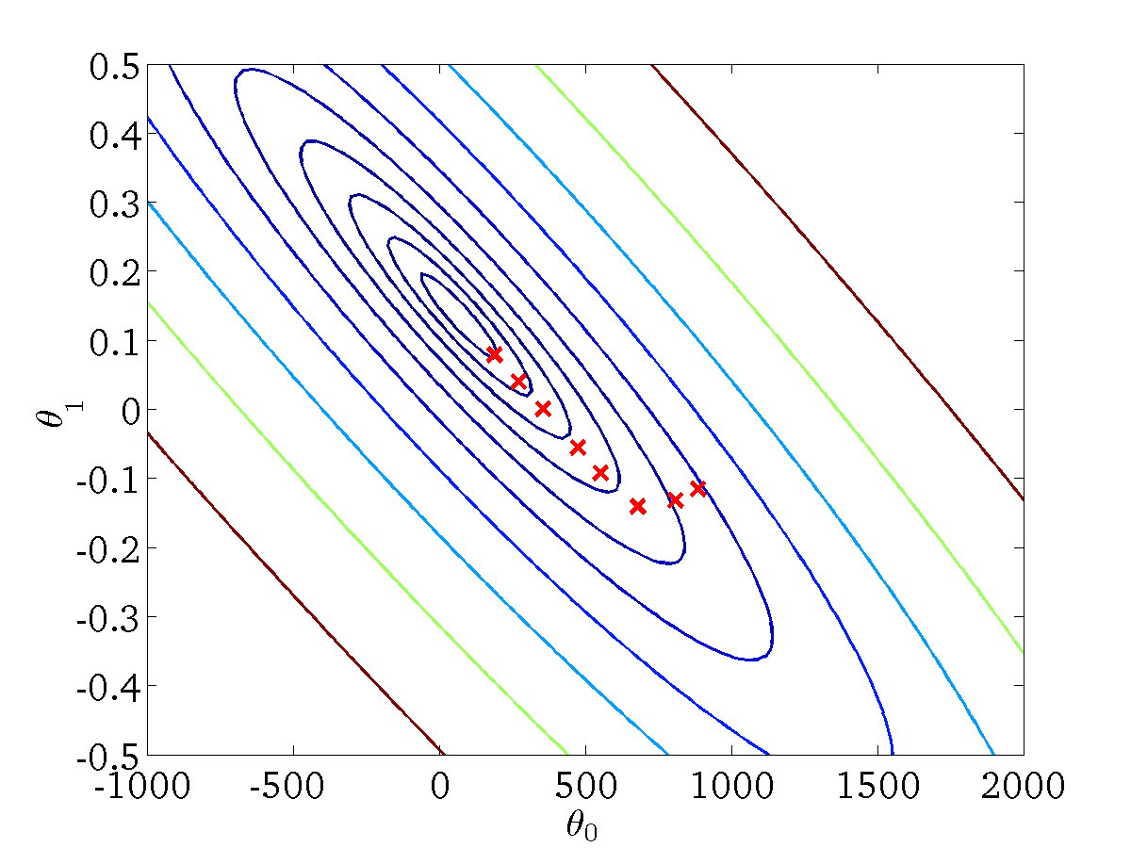
(for fixed , this is a function of x)
(function of the parameters )

Slide 10
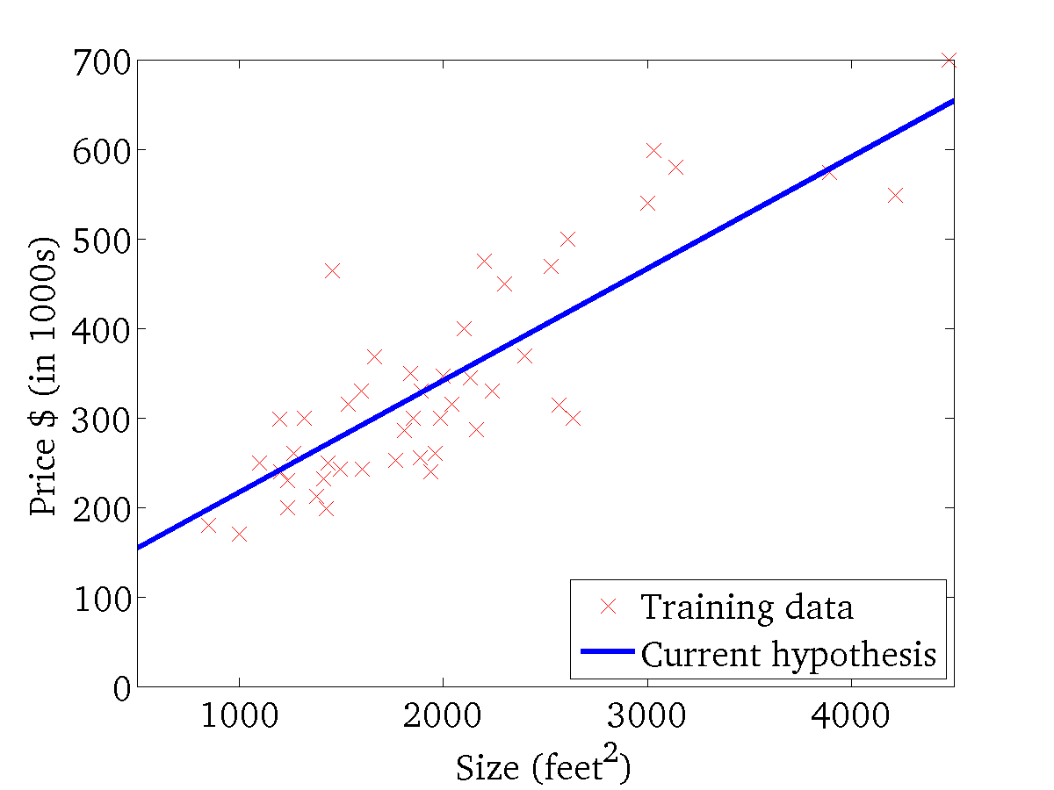

(for fixed , this is a function of x)
(function of the parameters )

Slide 11
Classification

Slide 12







Classification
Reviews (sentiment): positive / negative
Email: Spam / Not Spam
User / customer type:
Online Transactions: Fraudulent (Yes / No)
Tumor: Malignant / Benign
User Activity: laying / walking / setting / standing
$$0: "first class"$$
$$0:"negative class"$$
$$1:"second class"$$
$$y ∈\{0,1\}$$
$$y ∈\{0,1,2,…,k\}$$
$$1:"positive class"$$
$$k:"kth class"$$

Slide 13



Classification $y ∈\{0,1\}$
Hypothesis $h_{θ}\left(x\right) should be ether 0 or 1$
Simplification
$$h_{θ}\left(x\right) ≥0.5 then we predict y to be 1$$
$$h_{θ}\left(x\right) should be between 0 and 1$$
$$h_{θ}\left(x\right) <0.5 then we predict y to be 0$$
$$Logistic Regression: 0 ≤h_{θ}\left(x\right)≤1$$

Slide 14
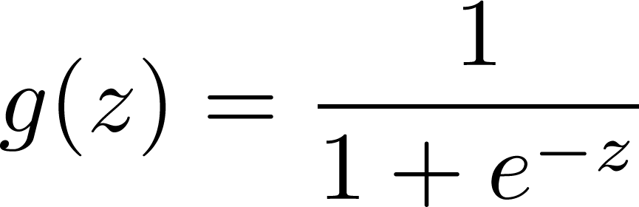
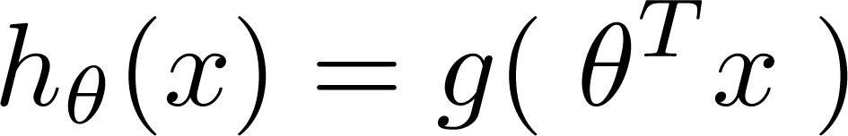
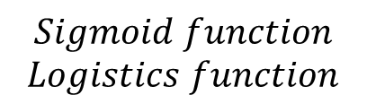
Logistic Regression Model
$$Sigmoid function$$
$$Logistics function$$
Notes:
Draw sigmoid function with 0.5 and 1 showing that when z = 0 h = 0.5

Slide 15
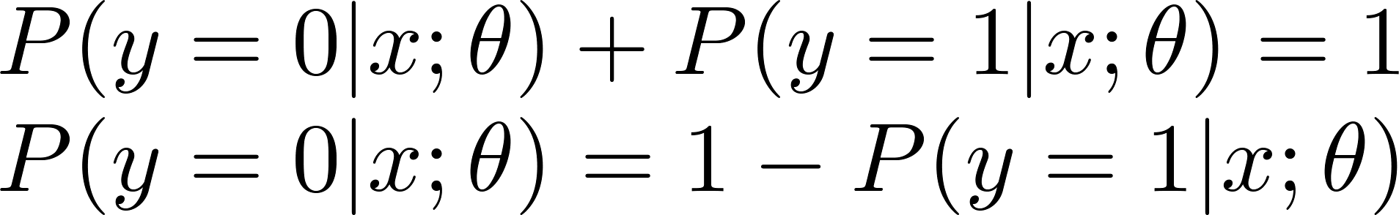
Interpretation of Hypothesis Output
$h_{θ}\left(x\right)$ = estimated probability that y = 1 on input x
$$Example \left(tumor classification\right) if: X= \left[\begin{matrix}1 \\ tumor size\end{matrix}\right]$$
$$if we get h_{θ}\left(x\right)=0.7 then the tumor has 70\% probability to be mailgnent$$
$$\text{“}\text{probability} \text{that} \text{y}\text{ = 1, }\text{given} \text{x}\text{,} \text{parameterized} \text{by} θ\text{”}$$
$$P\left(y=0 |x;θ\right)≡probability that the given x, θ is in calss 0$$
$$P\left(y=1 |x;θ\right)≡probability that the given x, θ is in calss 0$$

Slide 16






What Logistic Regression really do?
$$h_{θ}\left(z\right)=h(θ_{0}+θ_{1}x_{1}+θ_{2}x_{2})$$
$$1$$
$$x_{2}$$
Decision boundary
$$x_{1}$$
$$2$$
$$Predict y=1 if −2+x_{1}+2 x_{2}≥0$$

Slide 17




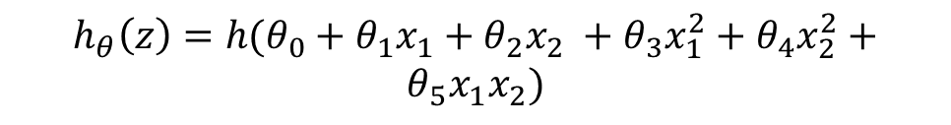


In non-linear case
$$h_{θ}\left(z\right)=h(θ_{0}+θ_{1}x_{1}+θ_{2}x_{2} +θ_{3}x_{1}^{2}+θ_{4}x_{2}^{2}+$$
$$θ_{5}x_{1}x_{2})$$
$$1$$
$$x_{2}$$
$$−1$$
$$1$$
Decision boundary
$$−1$$
$$x_{1}$$
$$Predict y=1 if −1+x_{1}^{2}+x_{2}^{2}≥0$$
Notes:
Draw the decision boundary around the blue circles

Slide 18
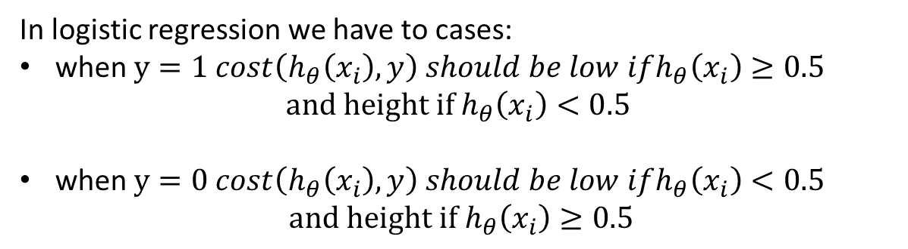
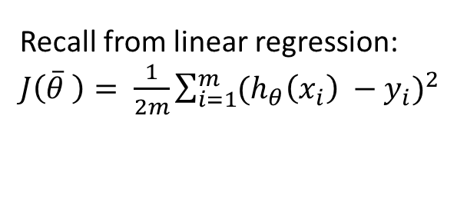
Logistics Regression Cost function
Recall from linear regression: $J\left(\overline{θ} \right)= \frac{1}{2m}\sum_{i=1}^{m}{{(h_{θ}\left(x_{i}\right) −y_{i})}^{2}}$
From calculus we do have a function with similar behaviour :
In logistic regression we have to cases:
when $y=1 cost\left(h_{θ}\left(x_{i}\right),y\right) should be low ifh_{θ}\left(x_{i}\right)≥0.5$
$$and height if h_{θ}\left(x_{i}\right)<0.5$$
when $y=0 cost\left(h_{θ}\left(x_{i}\right),y\right) should be low ifh_{θ}\left(x_{i}\right)<0.5$
$$and height if h_{θ}\left(x_{i}\right)≥0.5$$

Slide 19
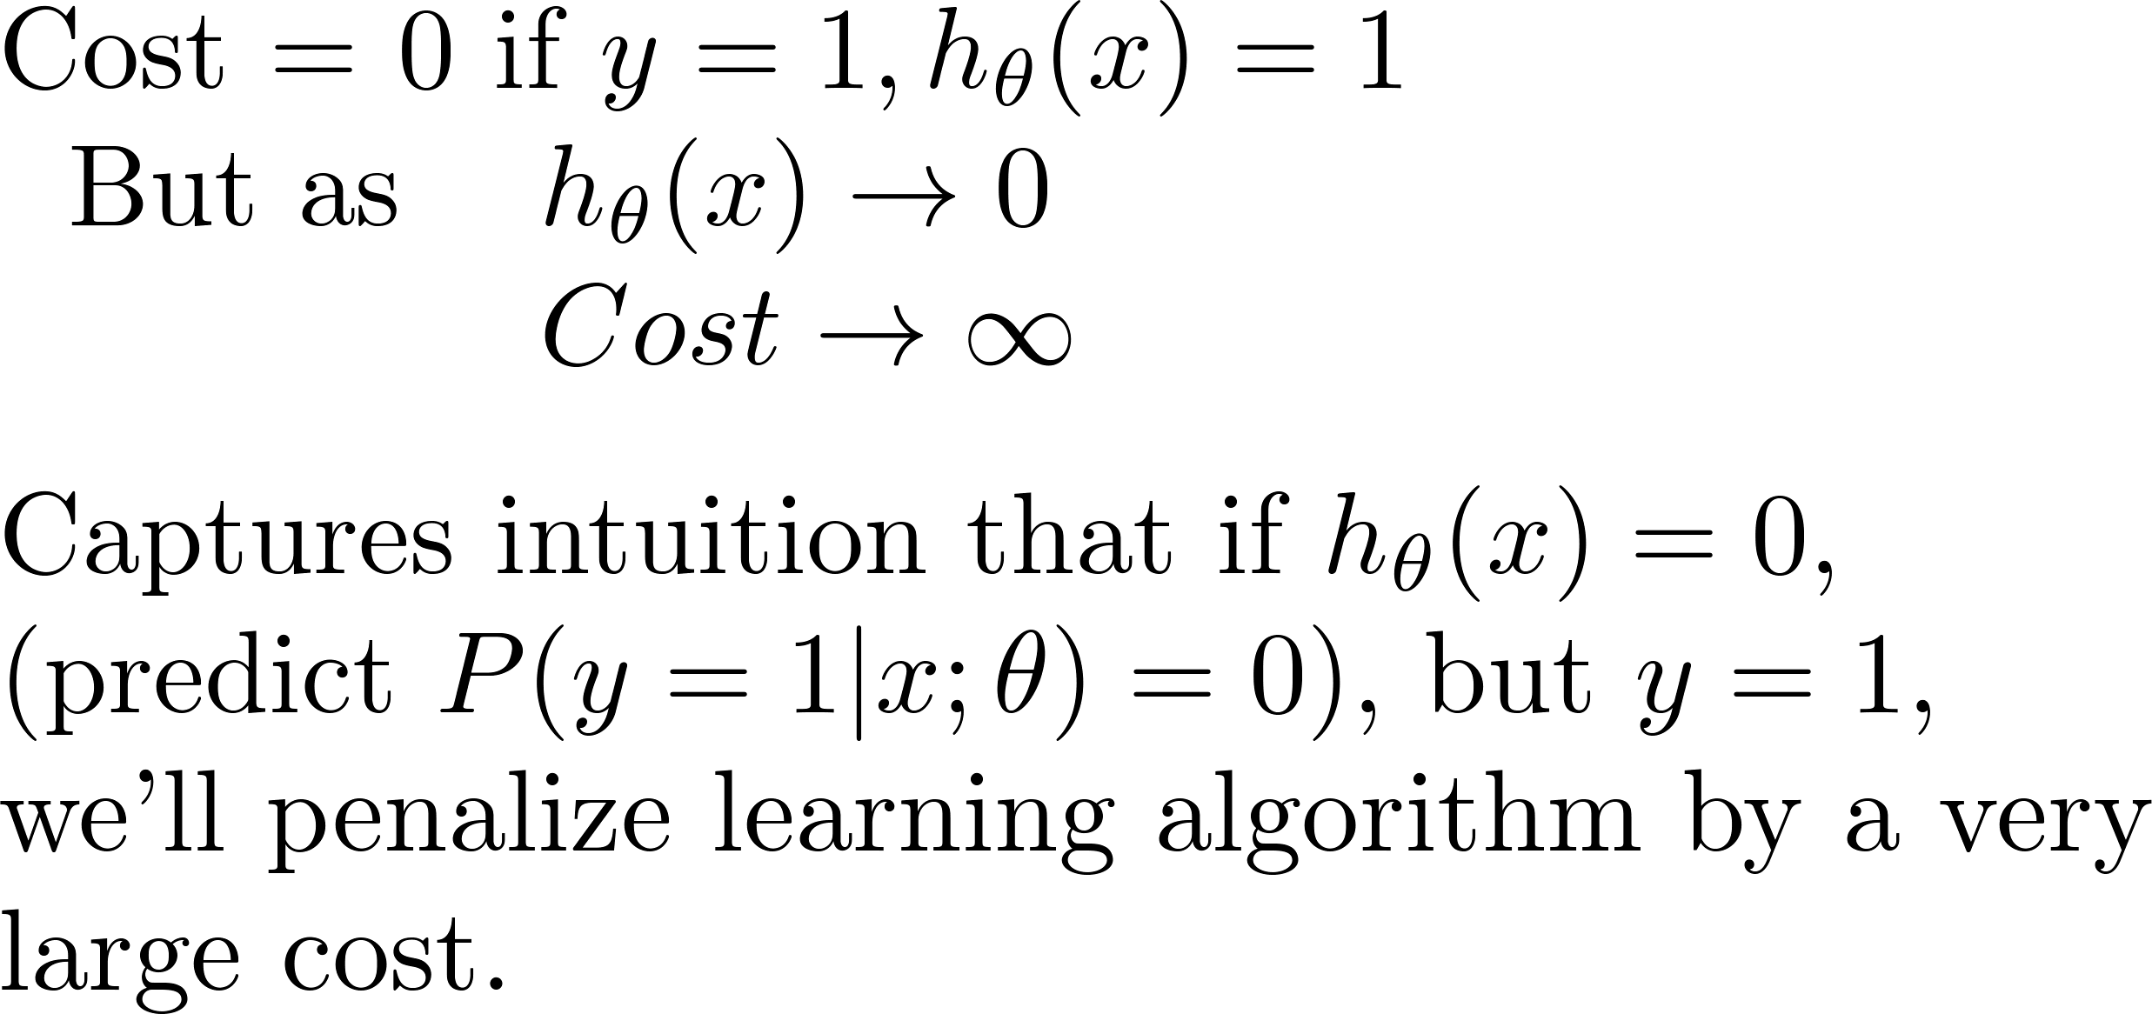
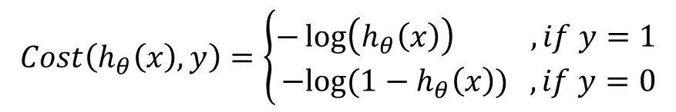



$$Cost\left(h_{θ}\left(x\right),y\right)=\left\{\begin{aligned}−&\log\left(h_{θ}\left(x\right)\right) ,if y=1 \\ −&log⁡(1−h_{θ}\left(x\right)) ,if y=0\end{aligned}\right.$$
$$0$$
$$h_{θ}\left(x\right)$$
$$1$$

Slide 20
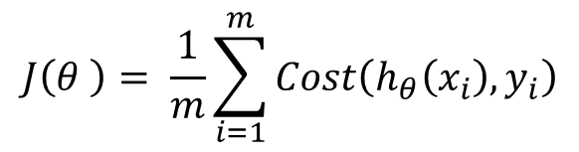
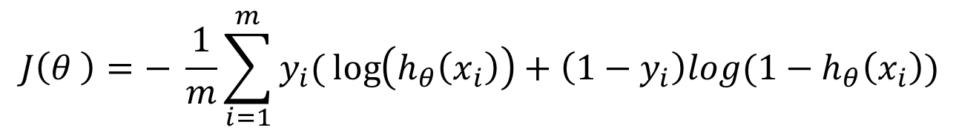
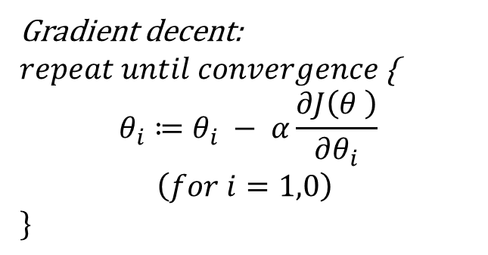
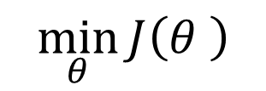
Logistic regression cost function
$$J\left(θ \right)= \frac{1}{m}\sum_{i=1}^{m}{Cost\left(h_{θ}\left(x_{i}\right),y_{i}\right)}$$
$$J\left(θ \right)=− \frac{1}{m}\sum_{i=1}^{m}{y_{i}(}\log\left(h_{θ}\left(x_{i}\right)\right)+\left(1−y_{i}\right)log(1−h_{θ}\left(x_{i}\right))$$
$$\min_{θ}{J\left(θ \right)}$$
Gradient decent:
$repeat until convergence${
$$θ_{i}≔θ_{i} − α\frac{∂J\left(θ \right)}{∂θ_{i}}$$
$$\left(for i=1,0\right)$$
$$\}$$
Notes:
Draw the derivative of the cost function

Slide 21
Multi-class classification: One-vs-all
Weather: Sunny, Cloudy, Rain, Snow
User Activity: laying / walking / setting / standing
Medical diagrams: Not ill, Cold, Flu

Slide 22
Binary-class classification:
Multi-class classification:
x₂
x₂
x₁
x₁

Slide 23
One-vs-all (one-vs-rest):
x₂
x₁
x₂
x₂
x₁
x₁
x₂
x₁

Slide 24
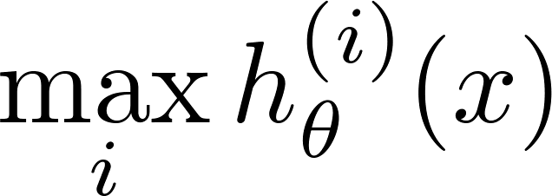


One-vs-all
Train a logistic regression classifier ${{ h}_{θ}}^{(i)}\left(x\right)$ for each class $i$ to predict the probability that $y=i$.
x₂
x₁
On a new input $x$, to make a prediction, pick the class $i$ that maximizes

Slide 25



